Slide 1

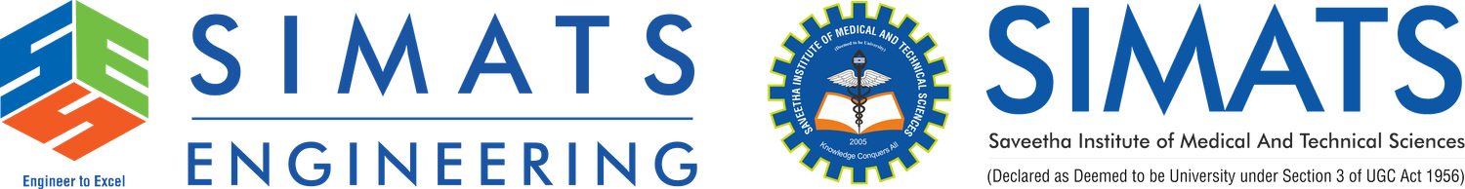



CSA1507 - CLOUD COMPUTING AND BIG DATA ANALYTICS
Quantum Computing as a Service (QCaaS):
The Next Frontier of Cloud Platforms
Guided By
Dr.Gnana Soundari
SIMATS Engineering
Presented By
192525280 - P.Dharani Govardhan
192525169 - Nagella Jeevan Sai

Slide 2
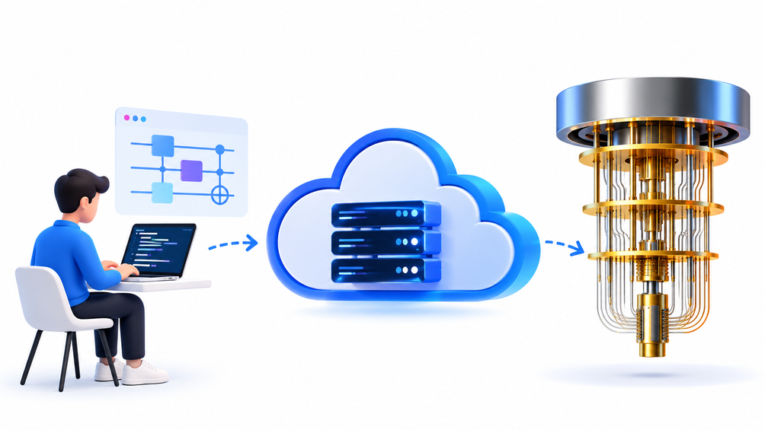
INTRODUCTION
  Quantum Computing uses qubits instead of traditional bits.
  Qubits use superposition and entanglement to process information.
  QCaaS provides quantum computing resources through the cloud.
  Users can access quantum hardware without owning or maintaining it.
  QCaaS makes quantum computing more accessible, scalable, and cost-effective.

Slide 3
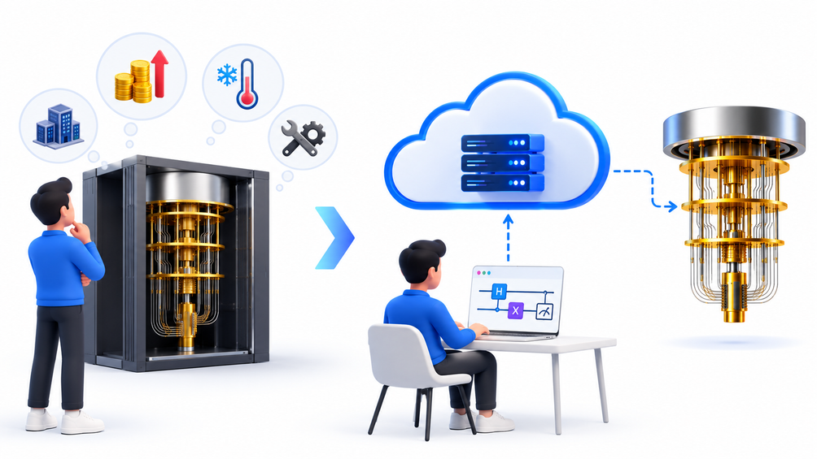
Why QCaaS?
  Expensive quantum hardware makes direct ownership difficult.
  QCaaS provides remote access to quantum computers through the cloud.
  Users can run quantum programs using cloud-based tools and APIs.
  It reduces the need for specialized infrastructure and maintenance.
  QCaaS makes quantum computing accessible to researchers, developers, and businesses.

Slide 4
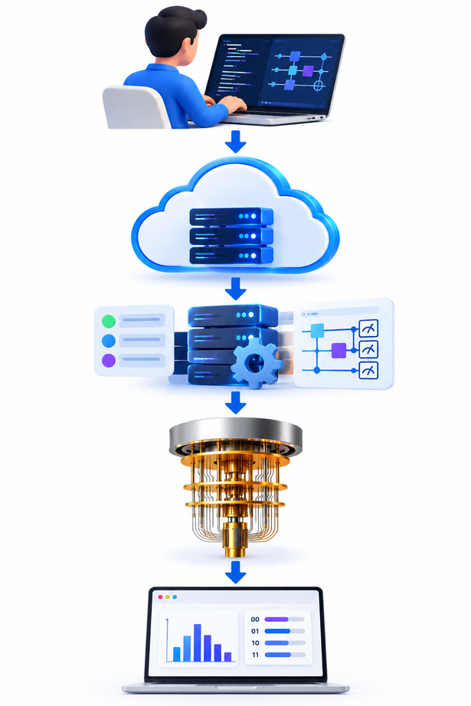
HOW QCAAS WORKS
  Quantum Program: User creates a quantum circuit using a quantum SDK.
  Cloud Submission: The program is sent to the QCaaS platform through the internet.
  Job Processing: The cloud platform schedules the job on a simulator or QPU.
  Quantum Execution: The quantum processor executes the circuit and measures the qubits.
  Result: Measurement results are returned to the user for analysis.

Slide 5
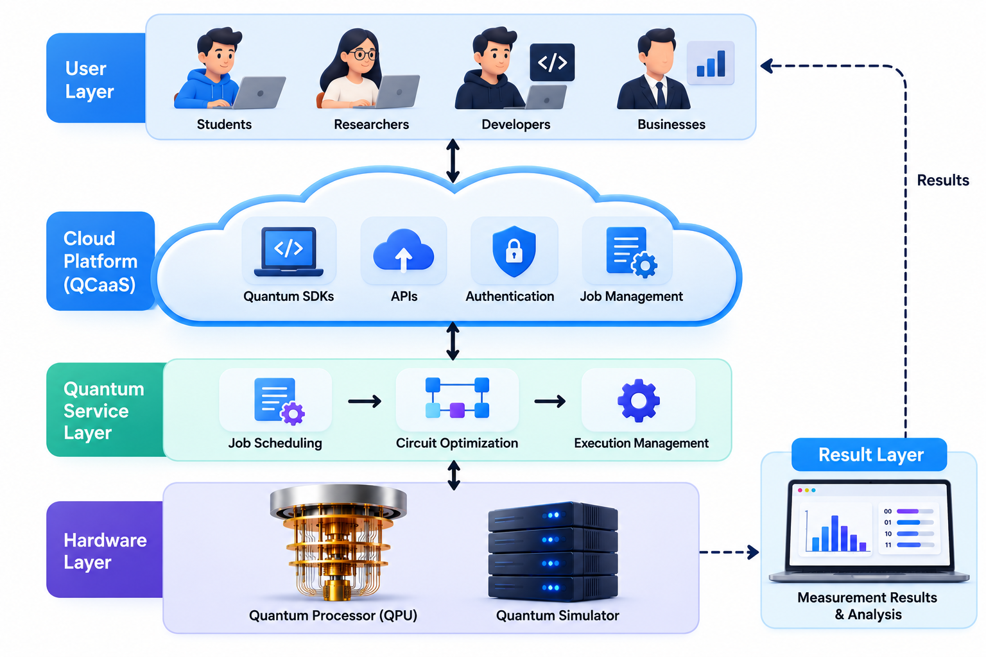
QCAAS ARCHITECTURE

Slide 6
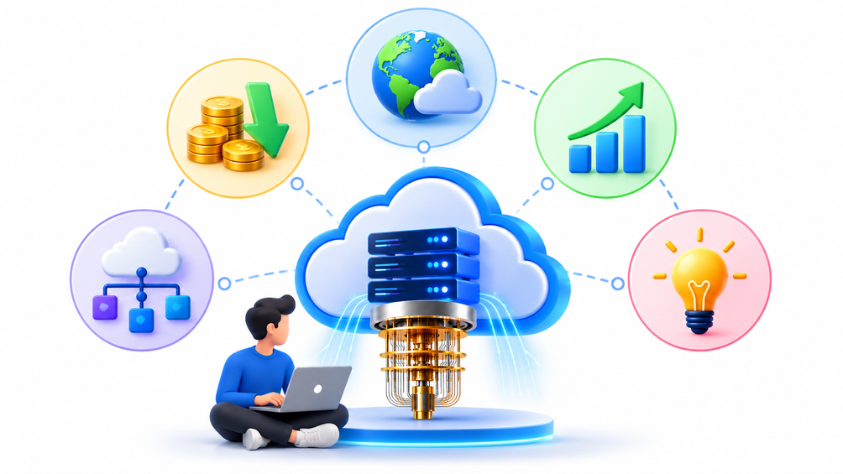
BENEFITS OF QCAAS
  Accessibility: Access quantum computers through the cloud from anywhere.
  Cost Efficiency: Avoid the high cost of owning quantum hardware.
  Scalability: Use different quantum processors and simulators as needed.
  Easy Integration: Connect quantum computing with existing cloud and classical systems.
  Faster Innovation: Enables researchers and businesses to experiment with quantum technology easily.

Slide 7
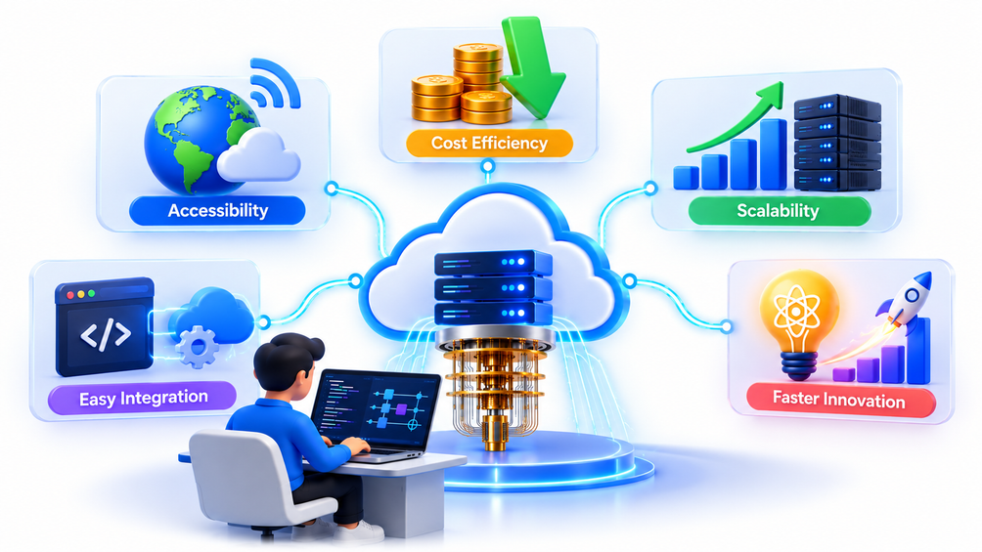
REAL-WORLD APPLICATIONS OF QCAAS
  Drug Discovery: Simulating molecules and accelerating new drug research.
  Finance: Portfolio optimization, risk analysis, and financial modeling.
  Automotive: Developing advanced materials and improving EV battery research.
  Logistics: Optimizing routes, scheduling, and supply-chain operations.
  Healthcare & AI: Exploring complex simulations and quantum-enhanced algorithms.

Slide 8
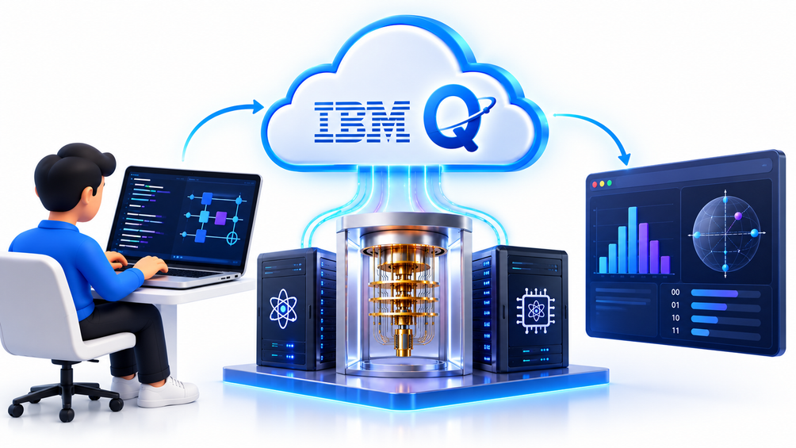
REAL-LIFE EXAMPLE: IBM QUANTUM
  IBM Quantum provides real quantum computers through a cloud-based platform.
  Users can create quantum circuits using Qiskit and submit them through the cloud.
  Jobs can run on IBM quantum processors or simulators.
  Researchers and businesses can experiment without owning quantum hardware.
  IBM Quantum demonstrates how QCaaS brings quantum computing to real-world users.

Slide 9
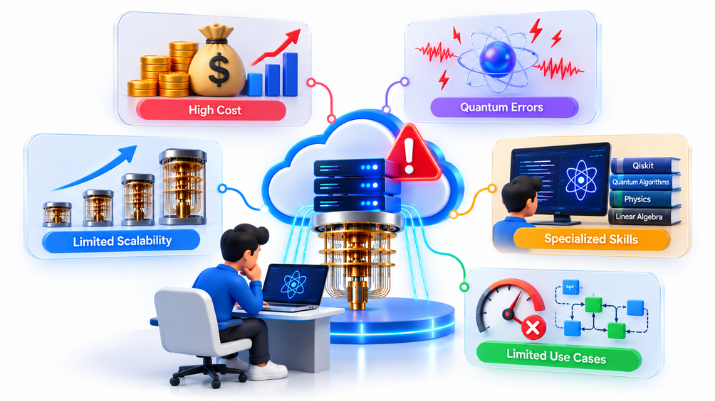
LIMITATIONS OF QCAAS
  High Cost: Advanced quantum hardware and cloud access can still be expensive.
  Quantum Errors: Qubits are sensitive to noise and environmental disturbances.
  Limited Scalability: Current quantum processors have limitations in qubit count and reliability.
  Specialized Skills: Quantum programming requires new technical knowledge.
  Limited Use Cases: Quantum computing is not faster for every type of problem.

Slide 10
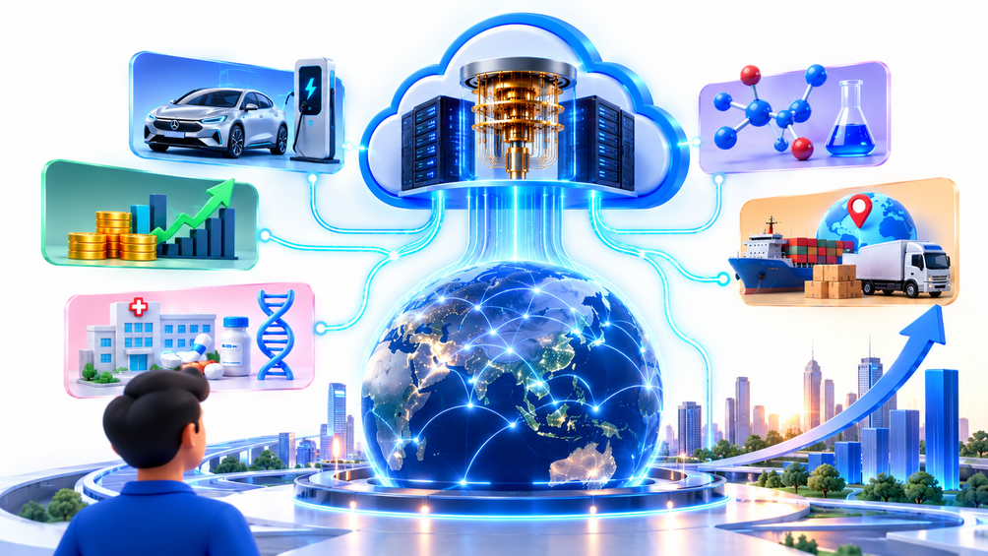
CONCLUSION
  QCaaS brings quantum computing to the cloud, making advanced quantum resources accessible remotely.
  It reduces the need for organizations to own and maintain quantum hardware.
  Real-world applications are emerging in automotive, finance, healthcare, chemistry, and logistics.
  Future improvements in qubit quality, error correction, and scalability can expand its practical use.
  QCaaS has the potential to become an important part of next-generation cloud platforms.

Slide 11


